Slide 1
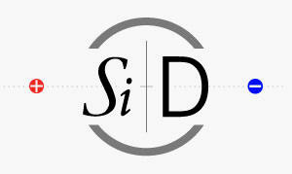

Ecal Resolution Studies and update
Jason Barkeloo
J. Brau, A. Steinhebel, E. Meyer, J. Carlson, D. Austin
UO Group Meeting
August 9, 2018

Slide 2
Outline
KPiX
Reminder of What Has Been Done
Test Beam Simulation and Comparison to KPiX data
How we start applying these to the full detector model
Current Geometry Studies
Effects on Resolution
Changing order and makeup of ECAL Layers
Quick Update on FCNC
Touching on Duplicate Event Removal
First Look at Data in Region Orthogonal to SR

Slide 3
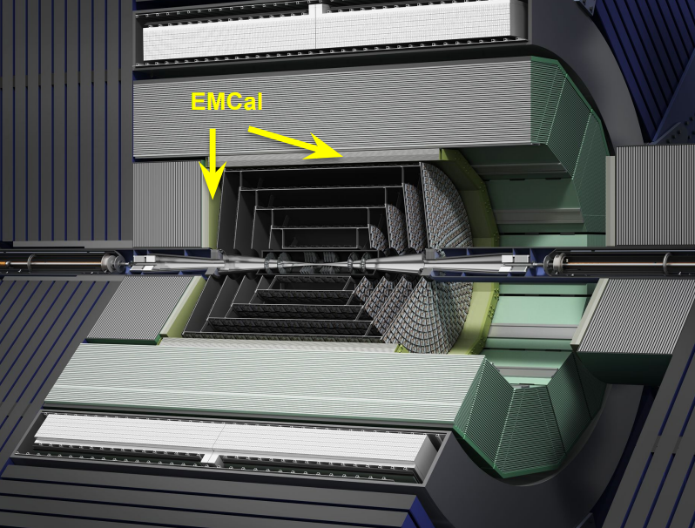
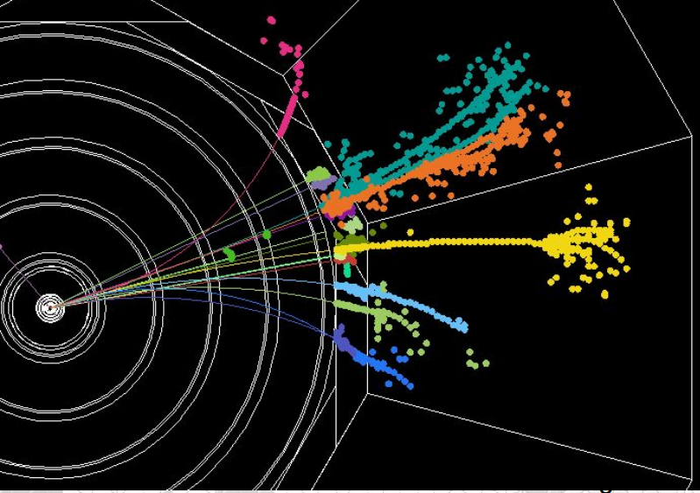
Particle flow Calorimetry
SiD has been designed to use Particle Flow Calorimetry to measure all final states with precision
We expect excellent jet energy resolution
Measure charged momenta with tracker, neutral energies with calorimeters
Requires very fine segmentation
An “Imaging ECAL” is a crucial part of the design
Silicon-Tungsten based calorimeter is being developed for a high granularity ECAL
KPiX ASIC for readout of silicon pixels

Slide 4
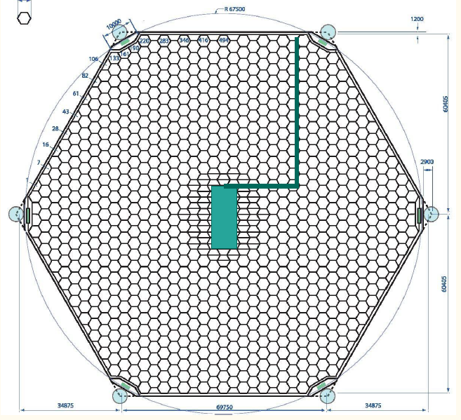
kPix
6 inch wafers
1024 13mm² pixels
Readout and cable are bump-bonded directly to the sensor
Test beam studies have happened with an initial version of this KPiX sensor design
Will come back to the geometry and its effect on resolution measurements

Slide 5
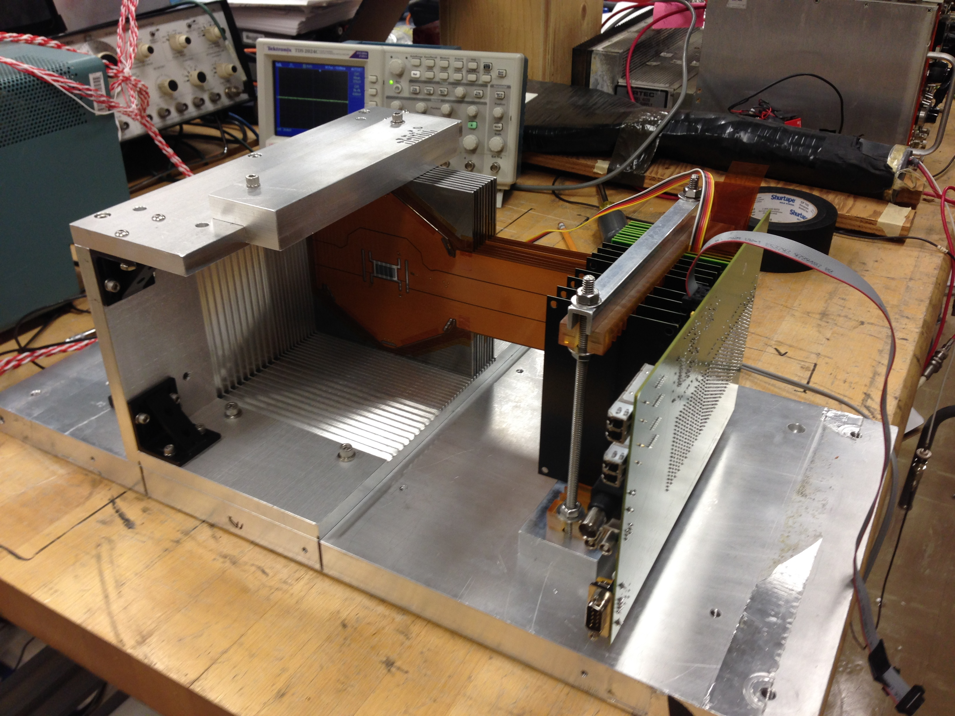
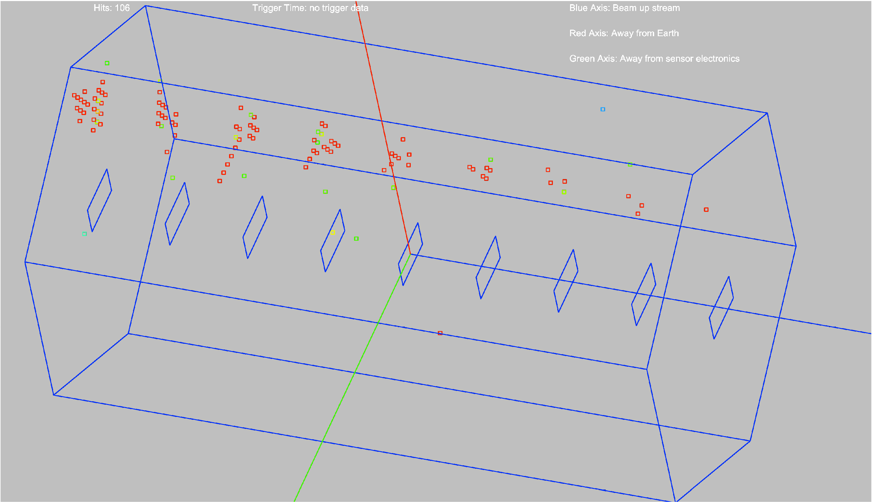
Test beam studies
Small 9 layer stack was placed into SLAC test beam
Sensor issues have been found and change the design going forward
Cross Talk, Dead Pixels, …
Many electron events were seen that we can analyze and compare with simulation to improve understanding of the system
Resolution, Identification (how well we can tell how many electrons are in an event)

Slide 6
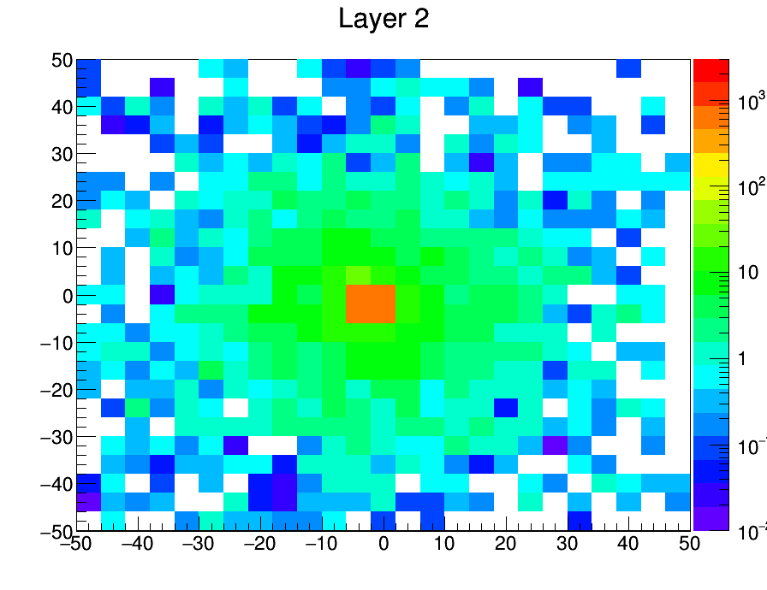
Simulation Studies
Geant4 Simulation created of 40x40cm plane of alternating Si (320 μm) and W (2.5mm,5/7 χ₀ )
40 (thin W) layer detector simulated simulated, only include 9 to match test beam stack for comparisons sake
Electrons fired at origin of various energies (in particular 12.1 GeV, test beam energy)
Want to try to match test beam running conditions
1000events, 10GeV. Energy in MeV deposited (all events summed) on the z-axis.

Slide 7
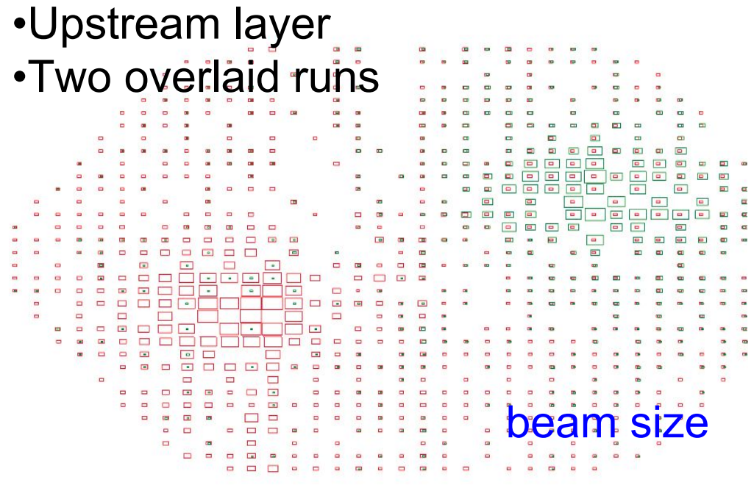
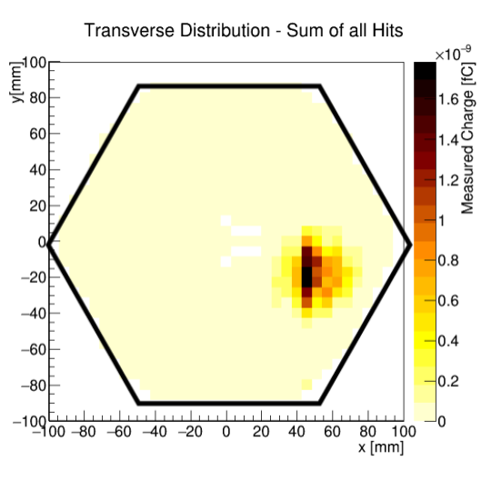
Comparisons (cont.)
Attempted to model distribution of electron multiplicity and errors in test beam
10% pixels randomly removed from each layer
Poisson distribution of simultaneous electrons per event used <n>=0.8725
Shifted from central area (more densely pixelated, also test beam was shifted away)
Match hit to KPiX pixel location

Slide 8
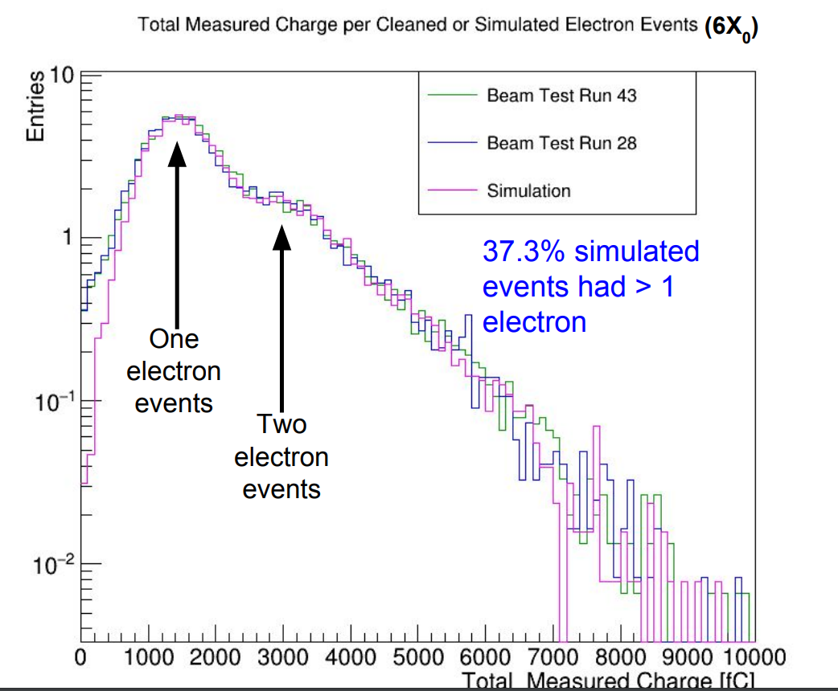
Comparisons (cont.)
Excellent agreement to test beam data.
Couldn’t remove all of the low E shoulder during test beam cleaning (lots of ~0fC hits)

Slide 9
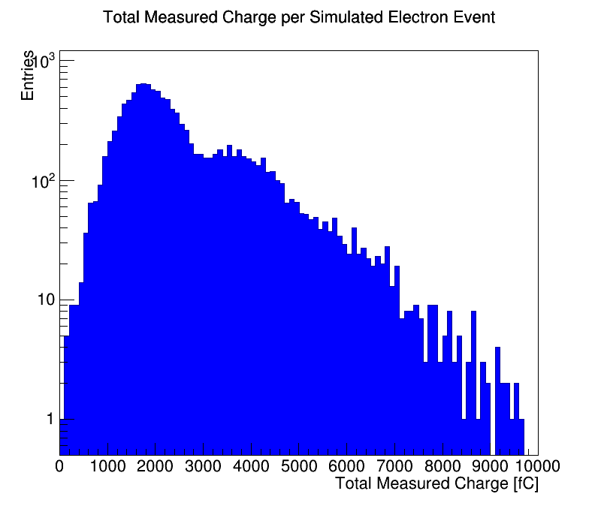
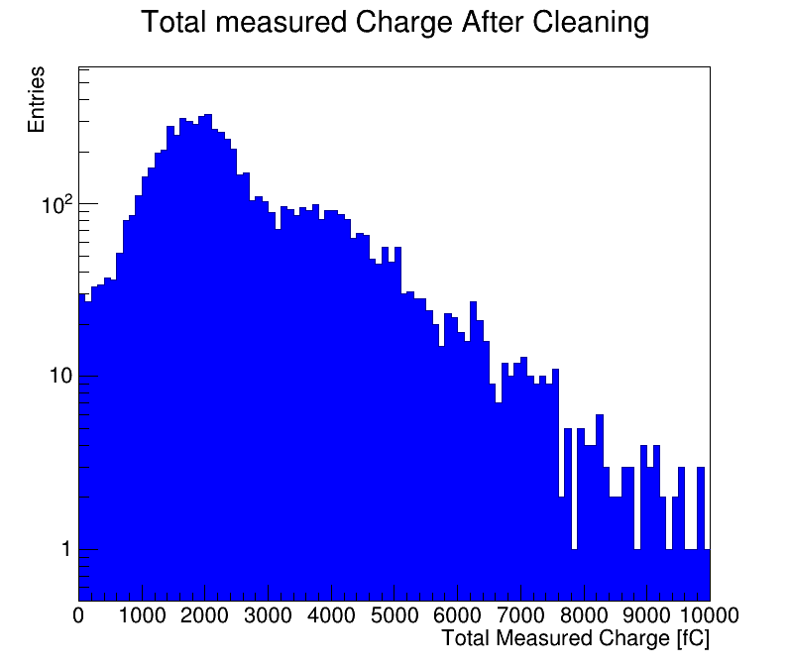
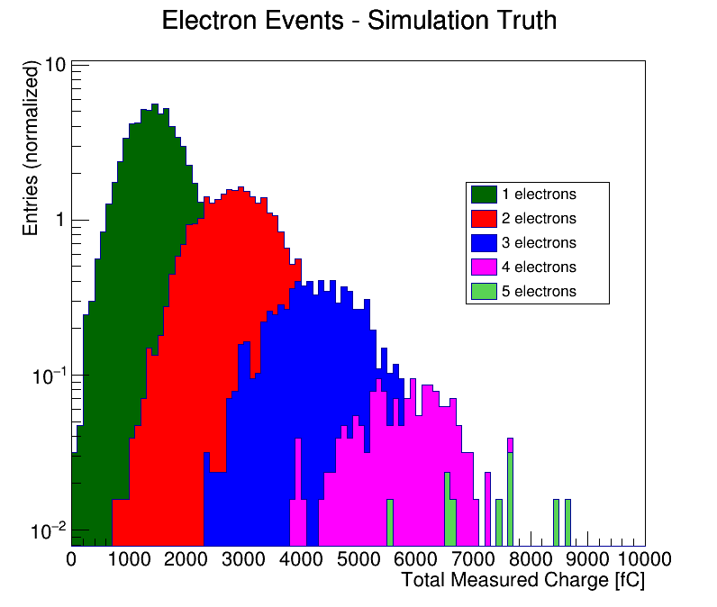
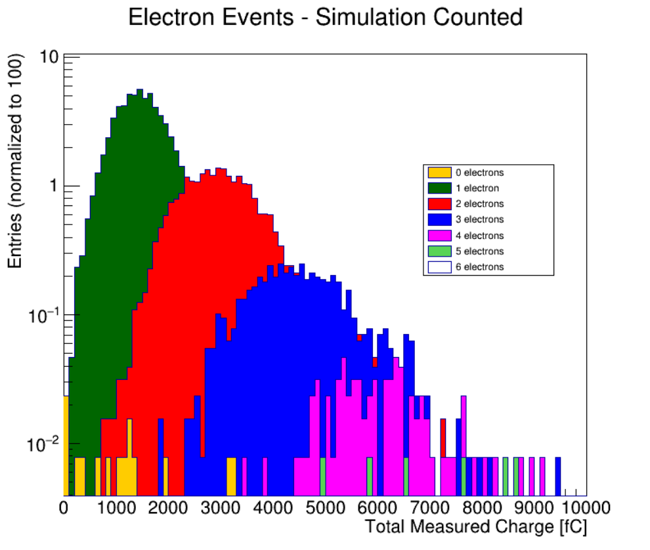
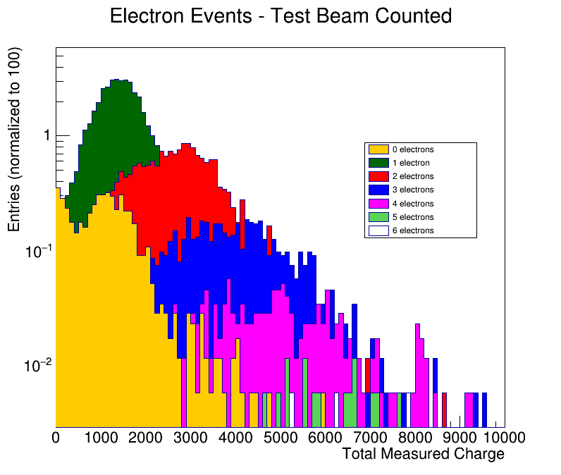
Counting Electrons
Algorithm used to count the number of electrons in the even based on energy distributions throughout the detector.

Slide 10
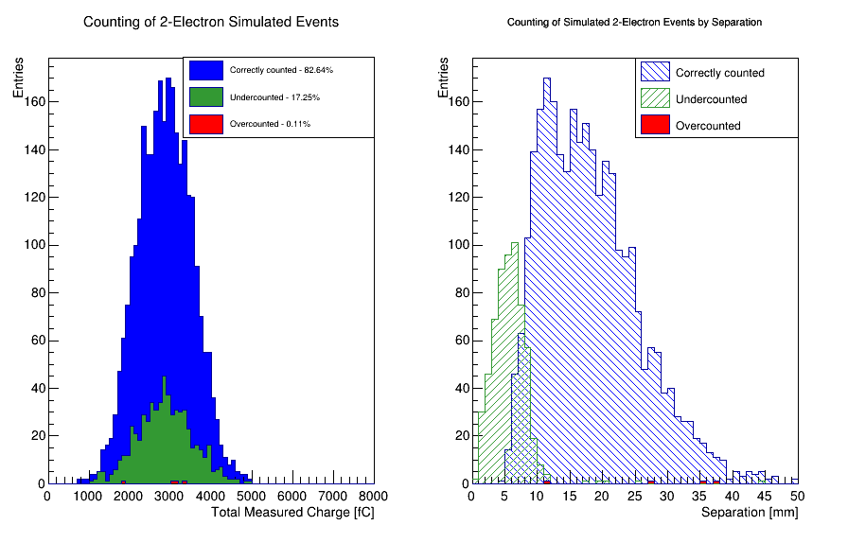
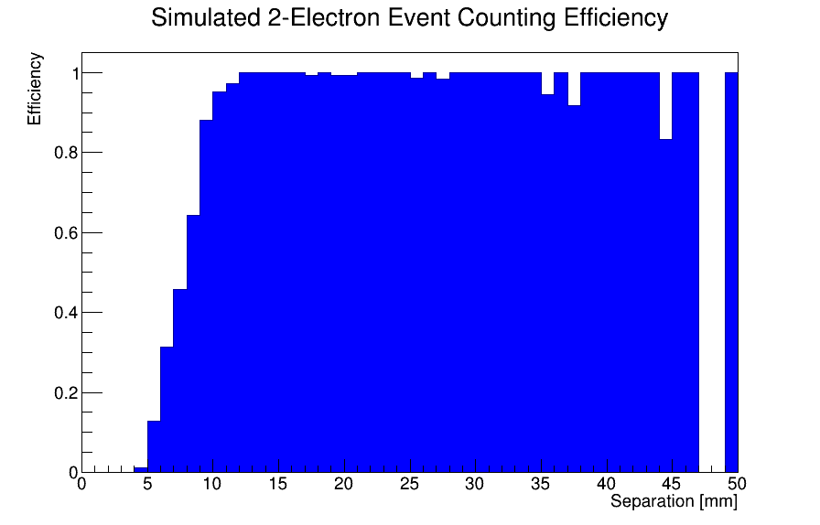
Counting Electrons (Cont.)
No field, just simple detector simulation

Slide 11
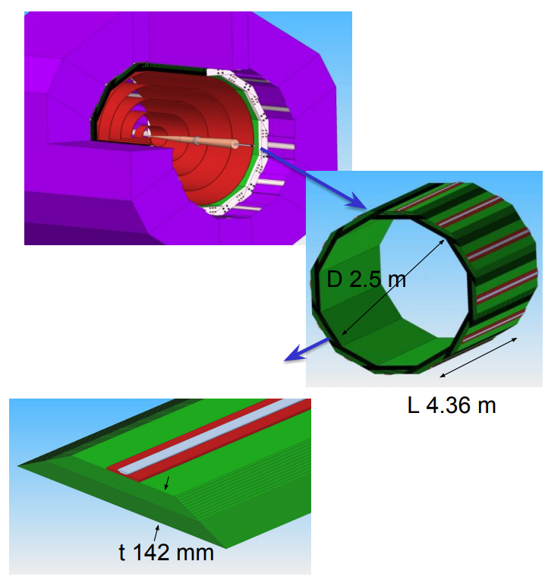
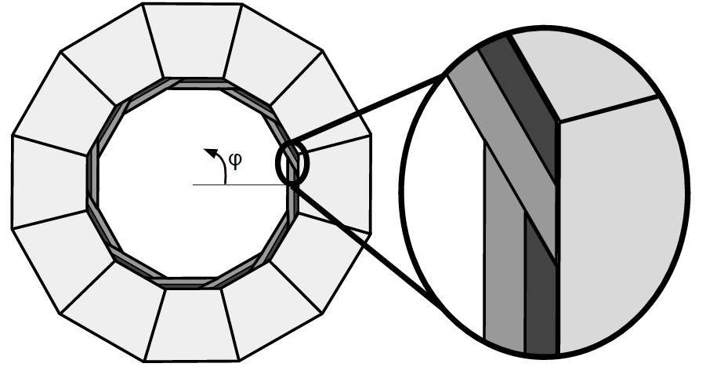
ECAL Geometry And its Effects
20 layers 2.5mm W
10 layers 5mm W
30 gaps 1.25mm w/pixel sensors
29 χ ₀

Slide 12
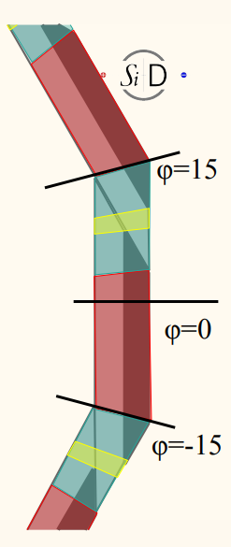
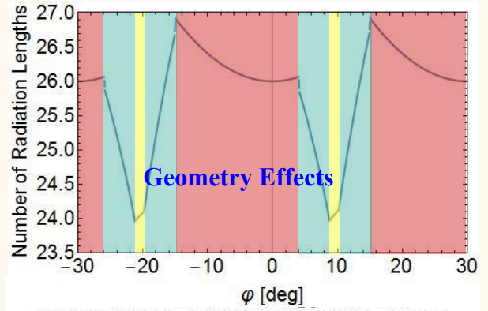
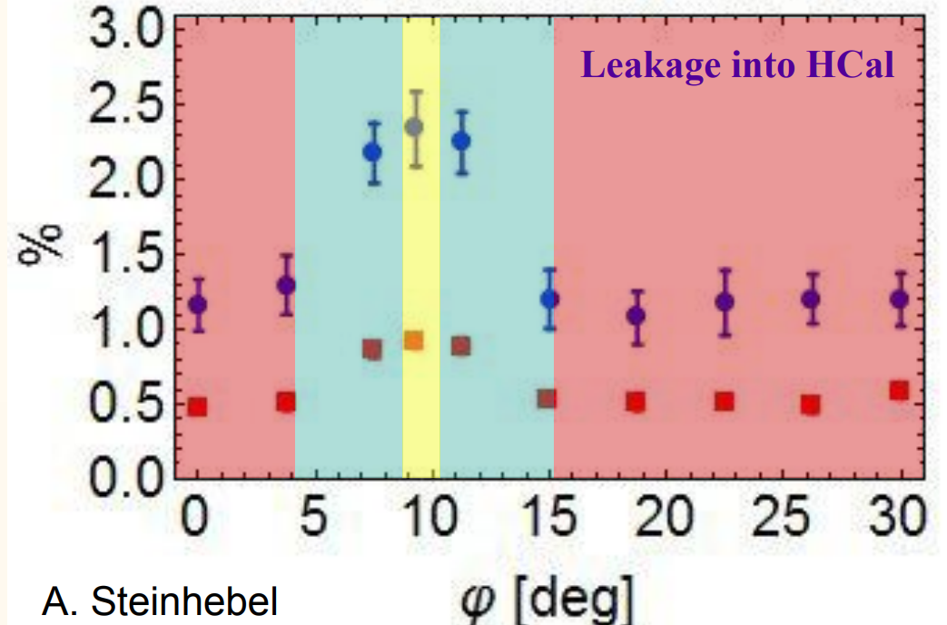
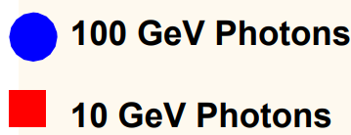
Geometry Effects
Leakage into HCAL in overlap region increases due to less material, phi dependent

Slide 13
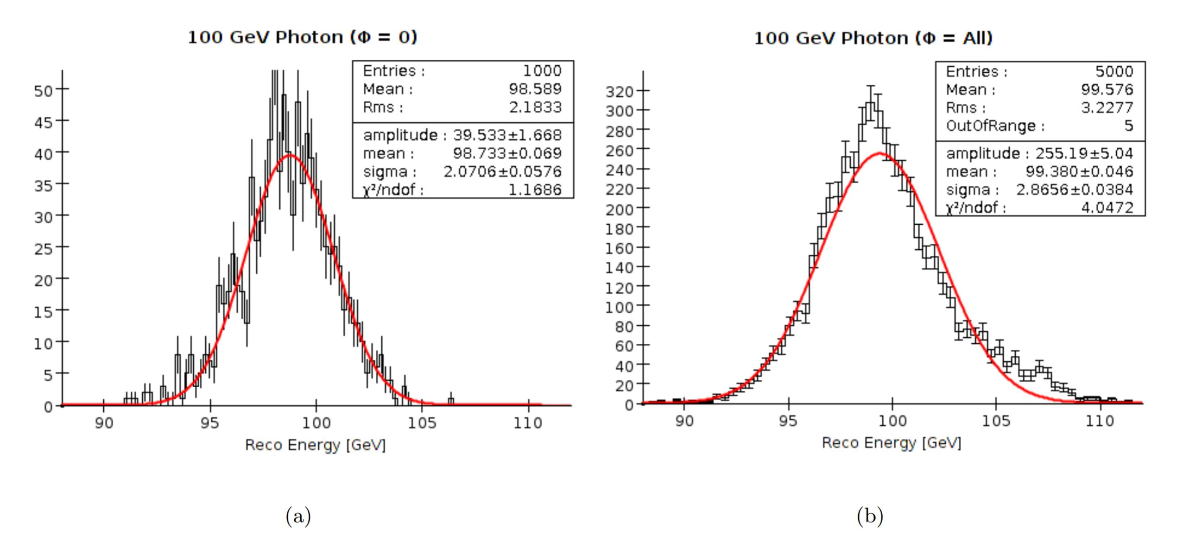
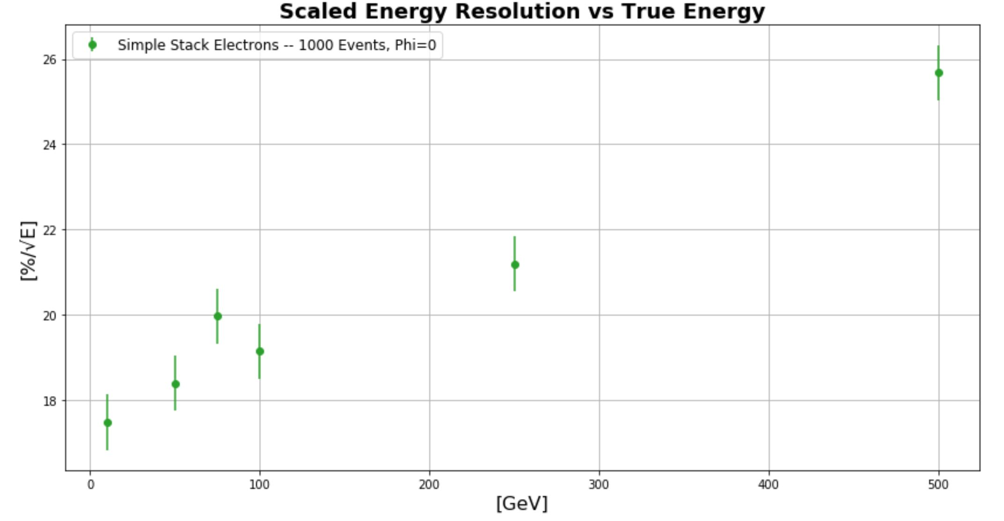
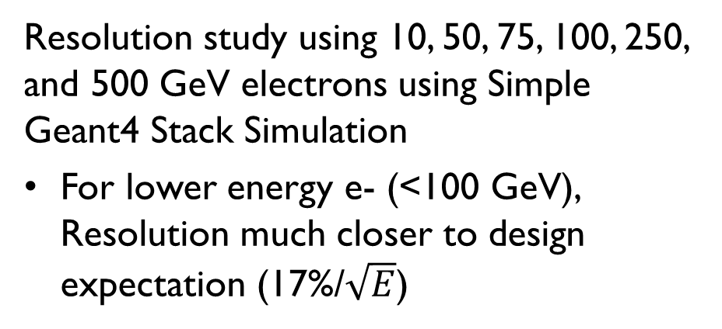
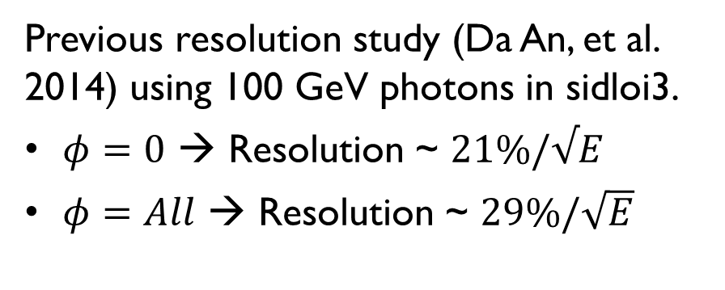
Resolution Effects from geometry
Previous resolution study (Da An, et al. 2014) using 100 GeV photons in sidloi3.
$φ=0$ → Resolution ~ $21\%/√E$
$φ=All$ → Resolution ~ $29\%/\sqrt{E}$
Resolution study using 10, 50, 75, 100, 250, and 500 GeV electrons using Simple Geant4 Stack Simulation
For lower energy e- (<100 GeV), Resolution much closer to design expectation (17%/$\sqrt{E}$)
E. Meyer

Slide 14
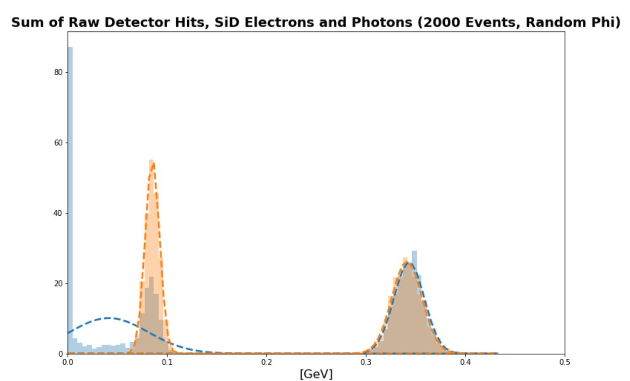
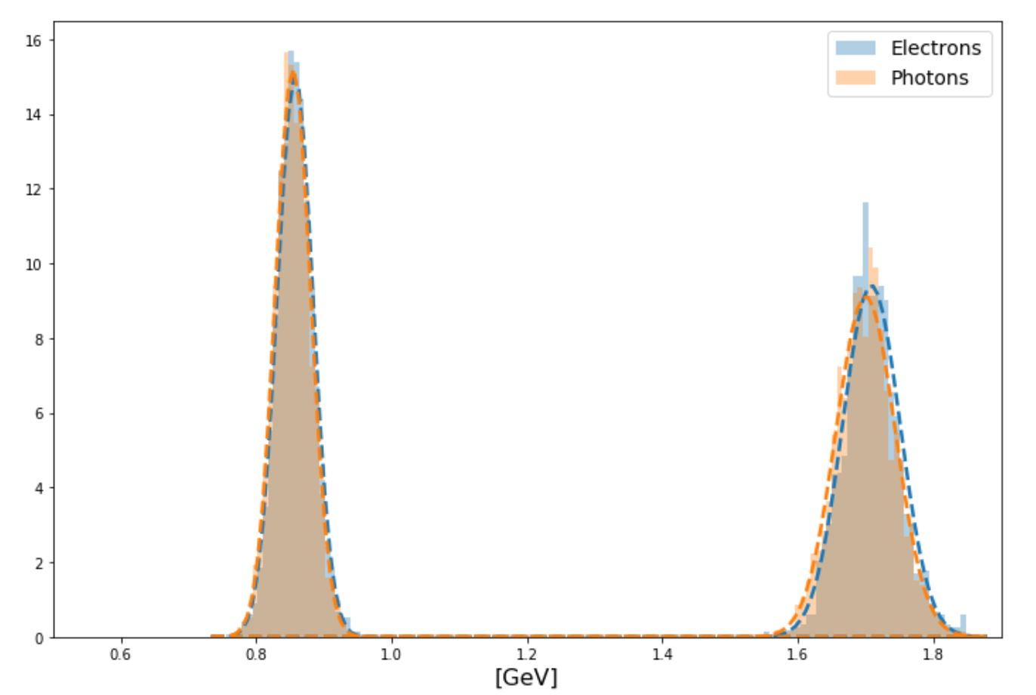
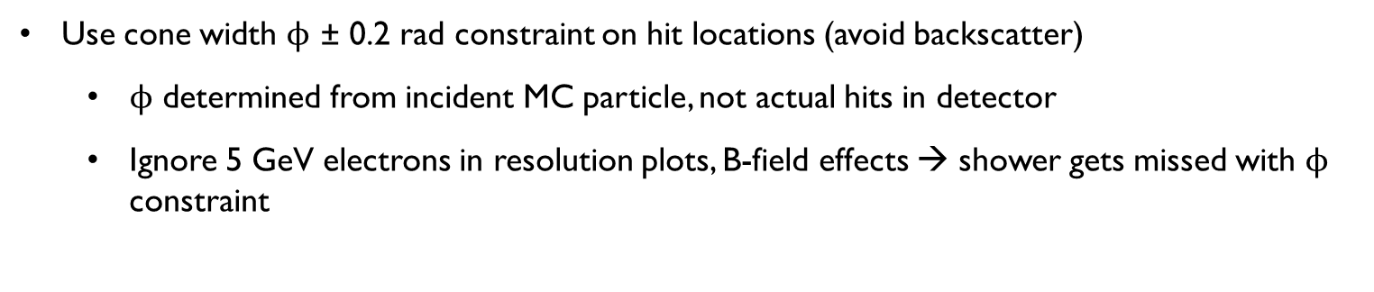
Distrubutions
50 GeV
5 GeV
100 GeV
10 GeV
Use cone width $ϕ$ ± 0.2 rad constraint on hit locations (avoid backscatter)
$ϕ$ determined from incident MC particle, not actual hits in detector
Ignore 5 GeV electrons in resolution plots, B-field effects → shower gets missed with $ϕ$ constraint

Slide 15
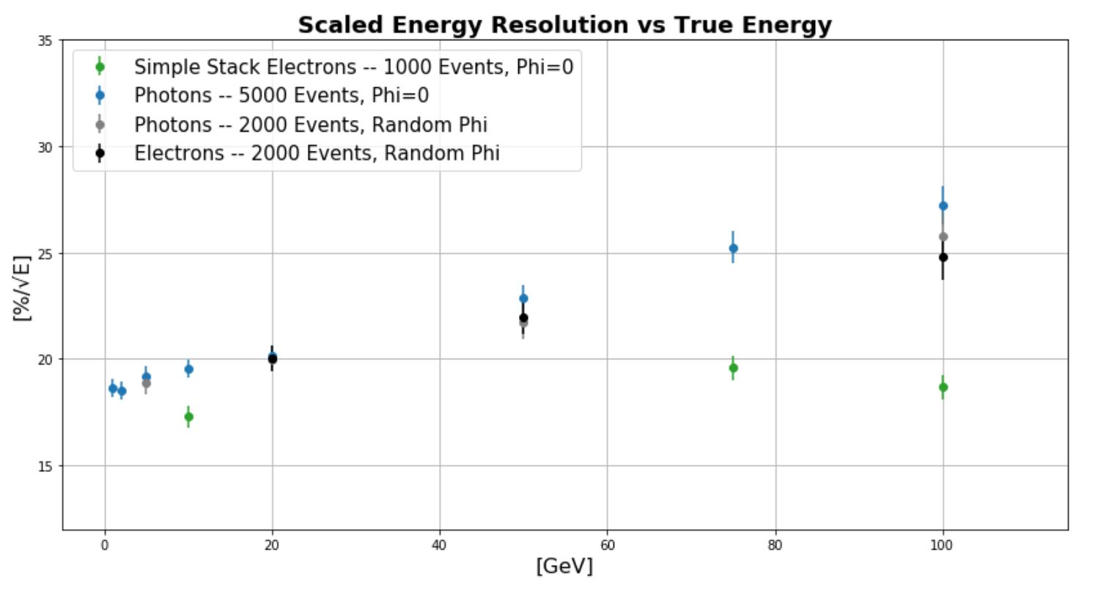
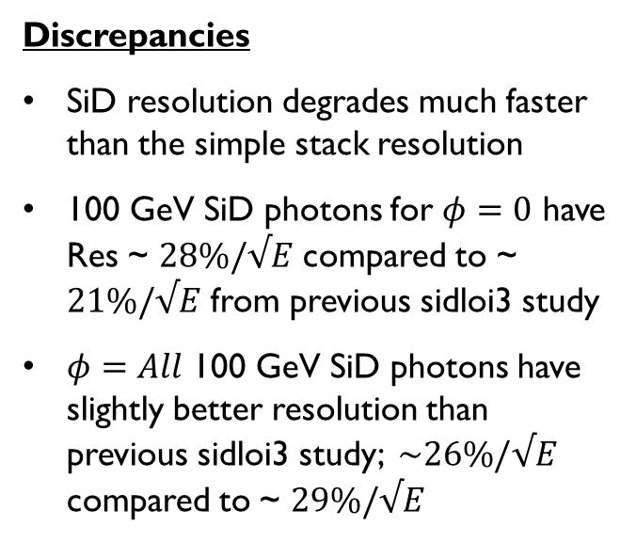
Comparisons
Discrepancies
SiD resolution degrades much faster than the simple stack resolution
100 GeV SiD photons for $φ=0$ have Res ~ $28\%/√E$ compared to ~ $21\%/√E$ from previous sidloi3 study
$φ=All$ 100 GeV SiD photons have slightly better resolution than previous sidloi3 study; $\sim 26\%/√E$ compared to ~ $29\%/√E$

Slide 16
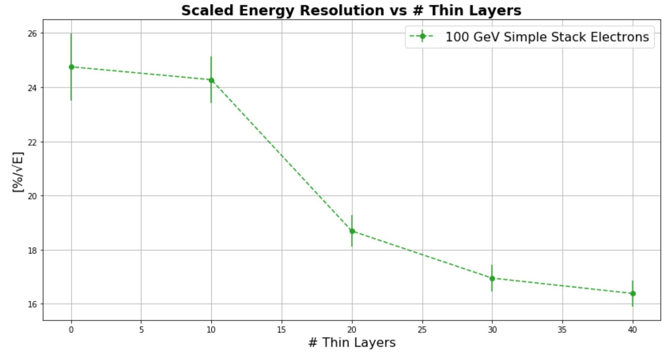
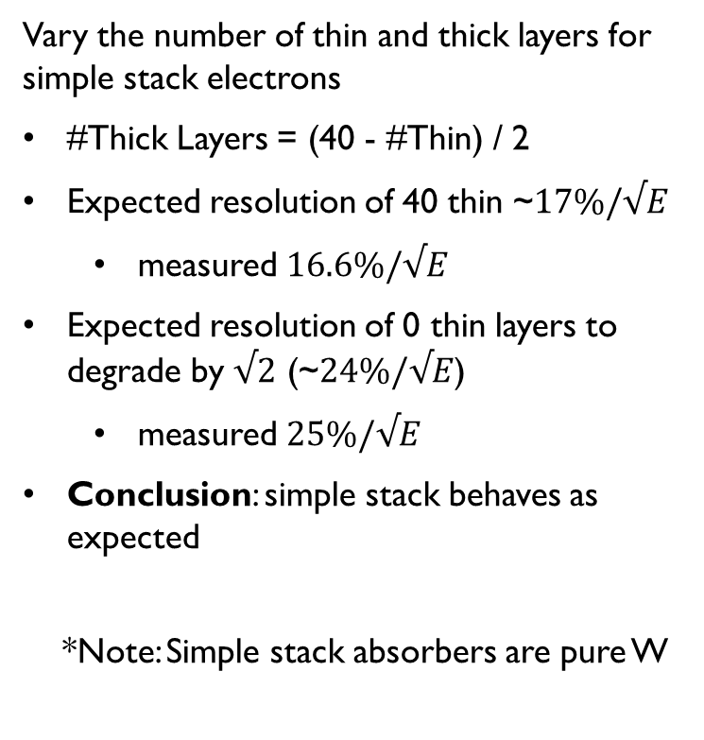
Confirm simple stack behaves as expected
Vary the number of thin and thick layers for simple stack electrons
#Thick Layers = (40 - #Thin) / 2
Expected resolution of 40 thin ~$17\%/√E$
measured $16.6\%/√E$
Expected resolution of 0 thin layers to degrade by $√2$ (~$24\%/√E$)
measured $25\%/√E$
Conclusion: simple stack behaves as expected
*Note: Simple stack absorbers are pure W

Slide 17
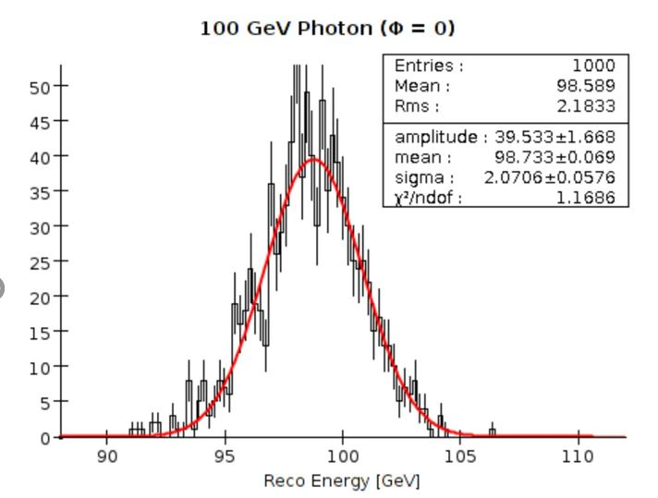
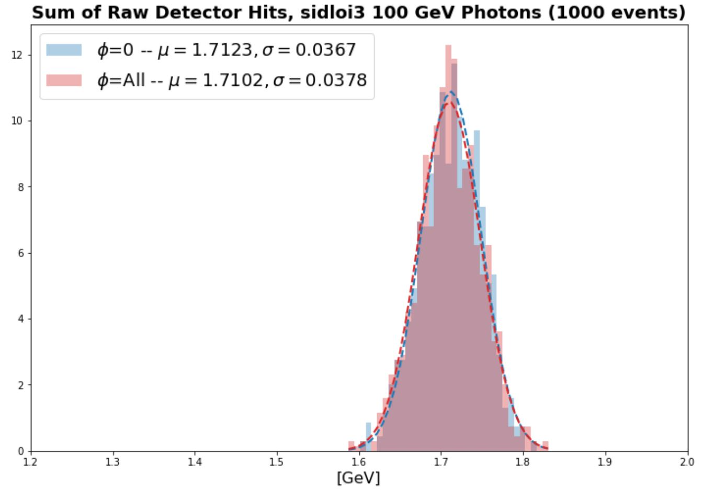
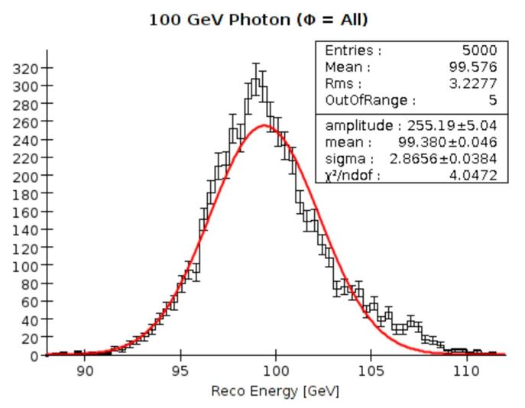
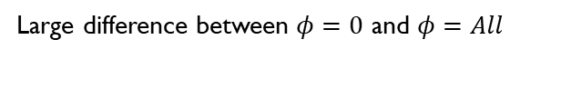
sidloi3 results
Previous study
(Da An, et al.)
Current study →
(what is used on following resolution plot)
Small/negligible difference between $φ=0$ and $φ=All$
Large difference between $φ=0$ and $φ=All$

Slide 18
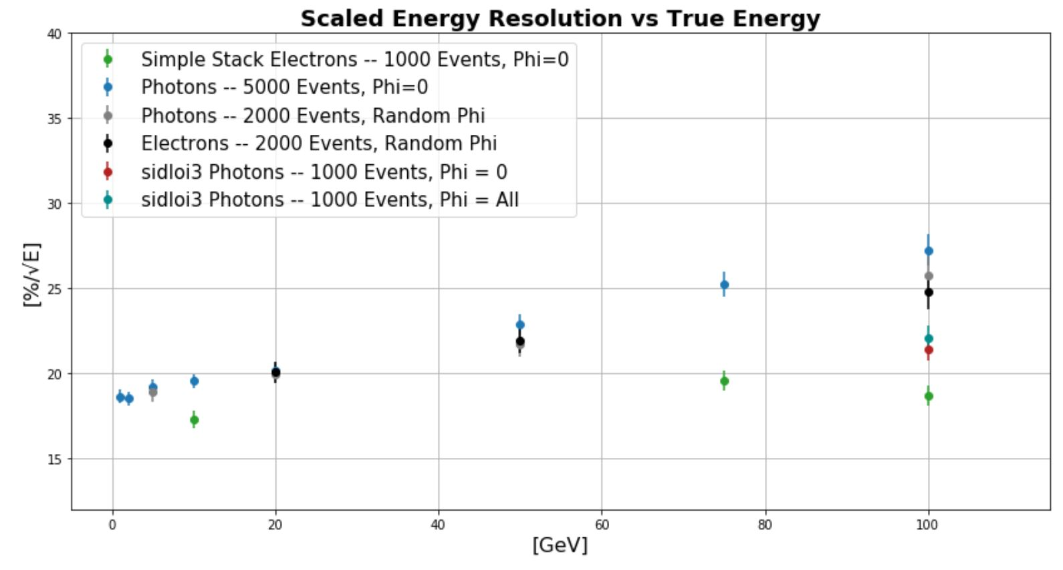
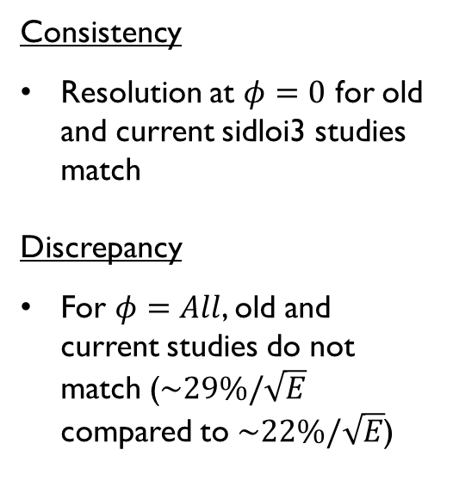
SIDloi3 Results (cont.)
Consistency
Resolution at $φ=0$ for old and current sidloi3 studies match
Discrepancy
For $φ=All$, old and current studies do not match ($\sim 29\%/\sqrt{E}$ compared to $\sim 22\%/\sqrt{E}$)

Slide 19
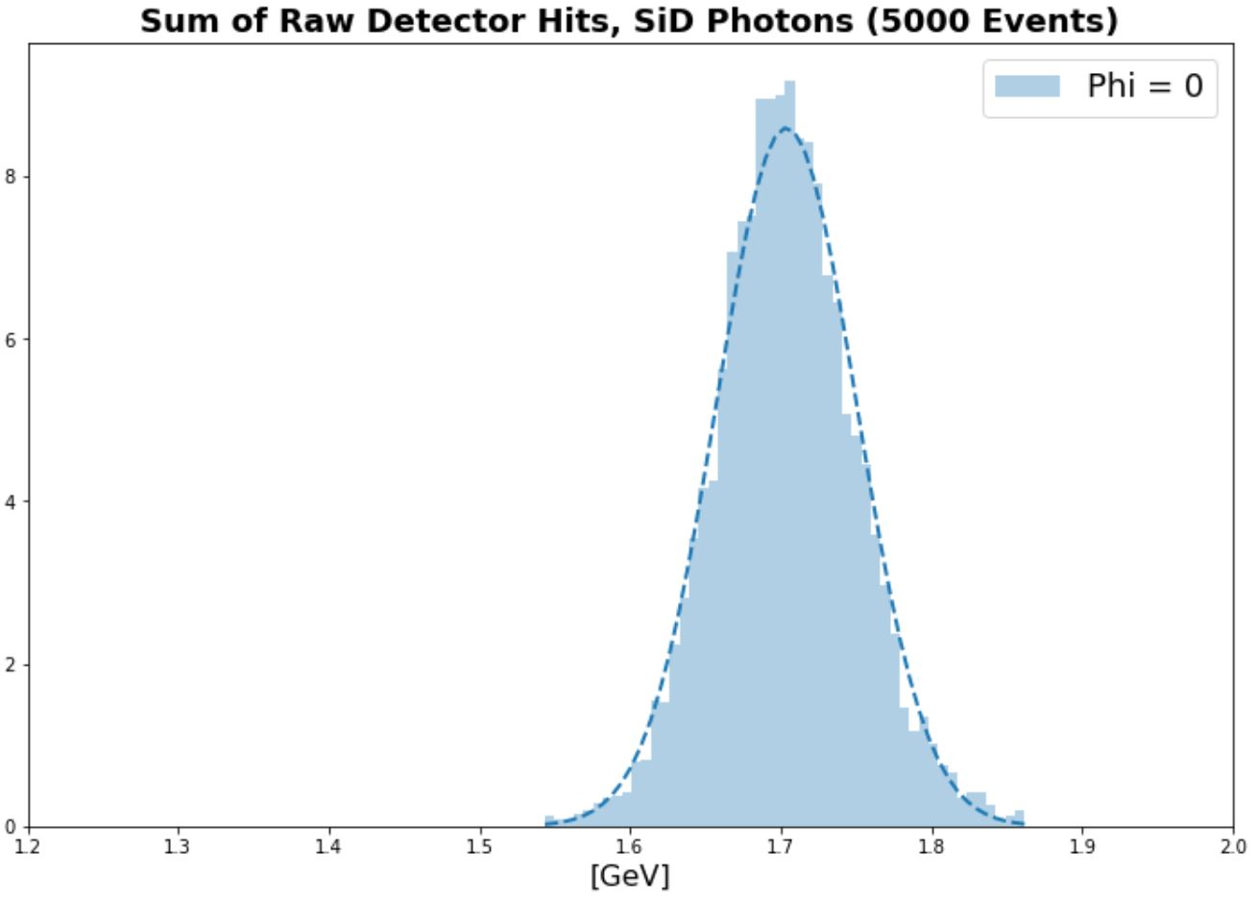
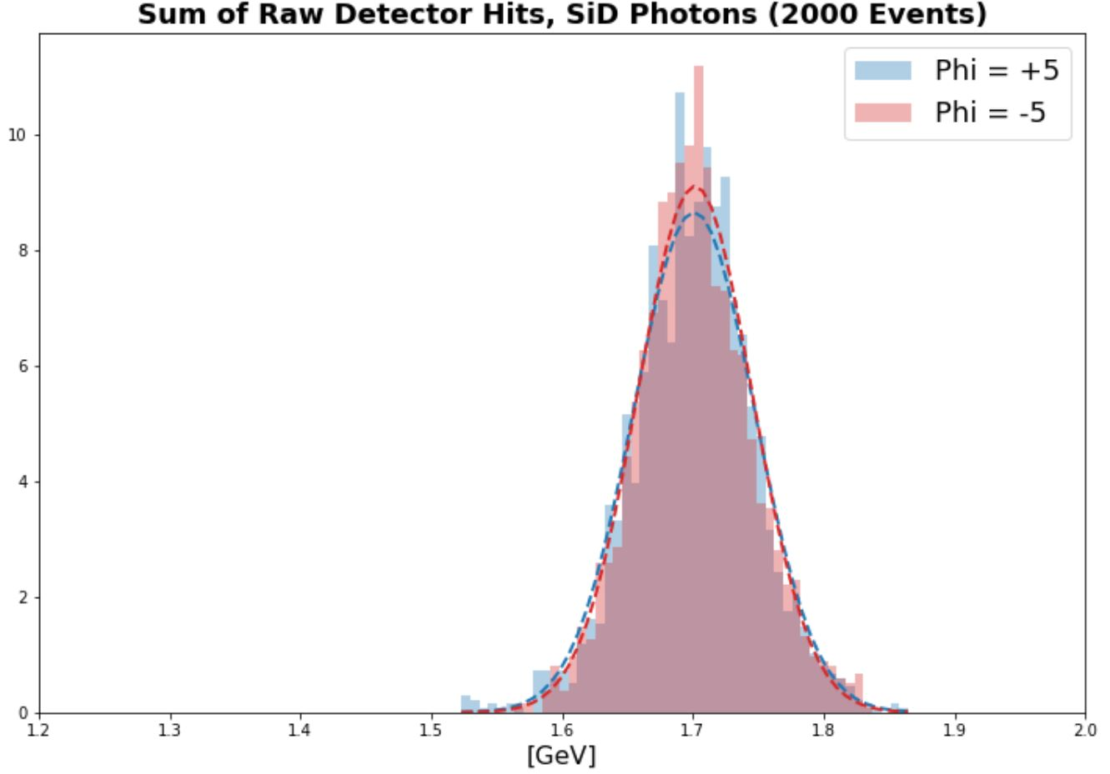
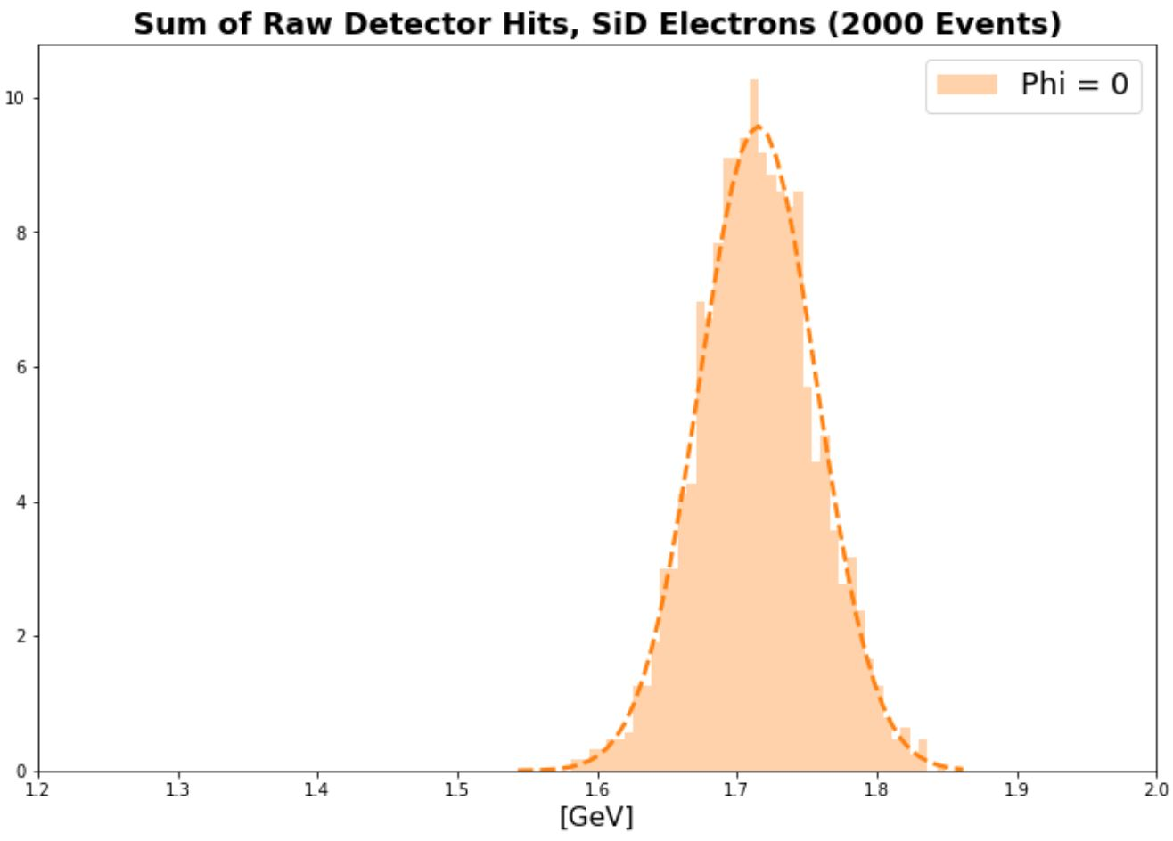
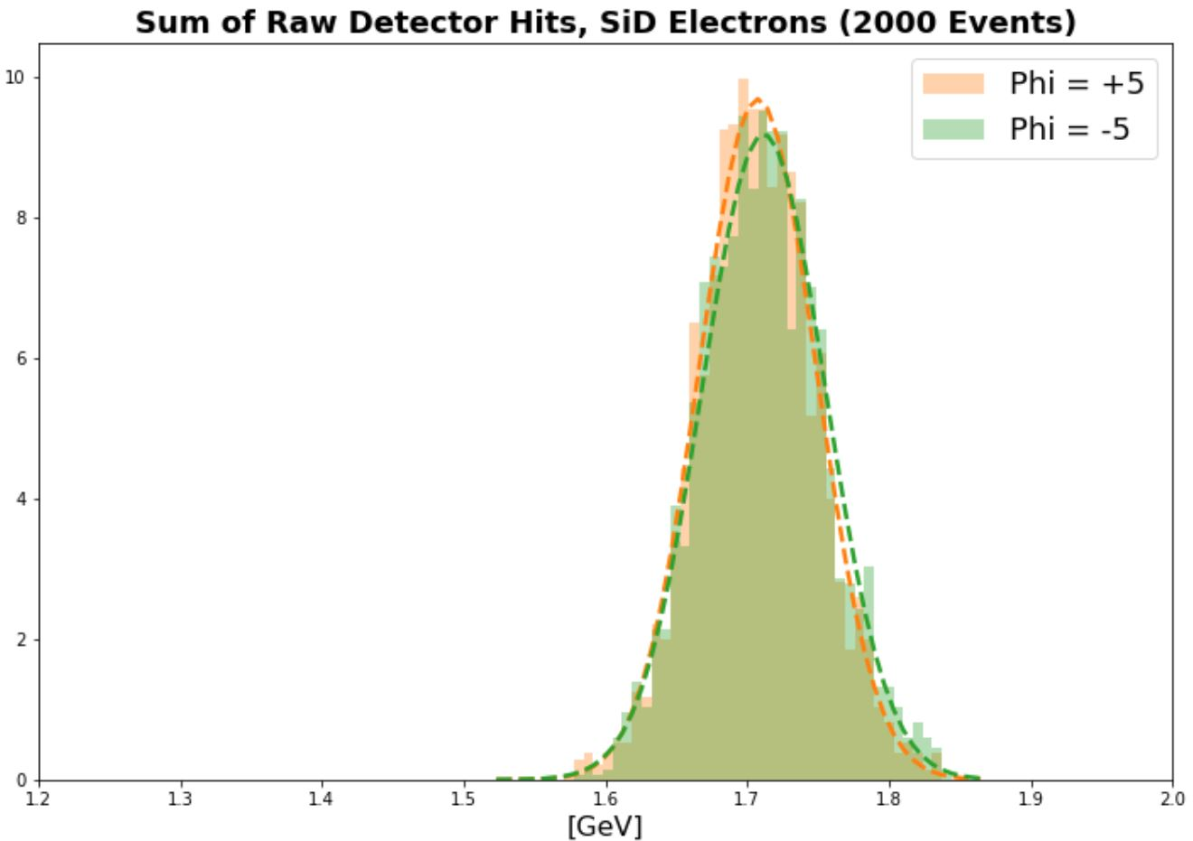
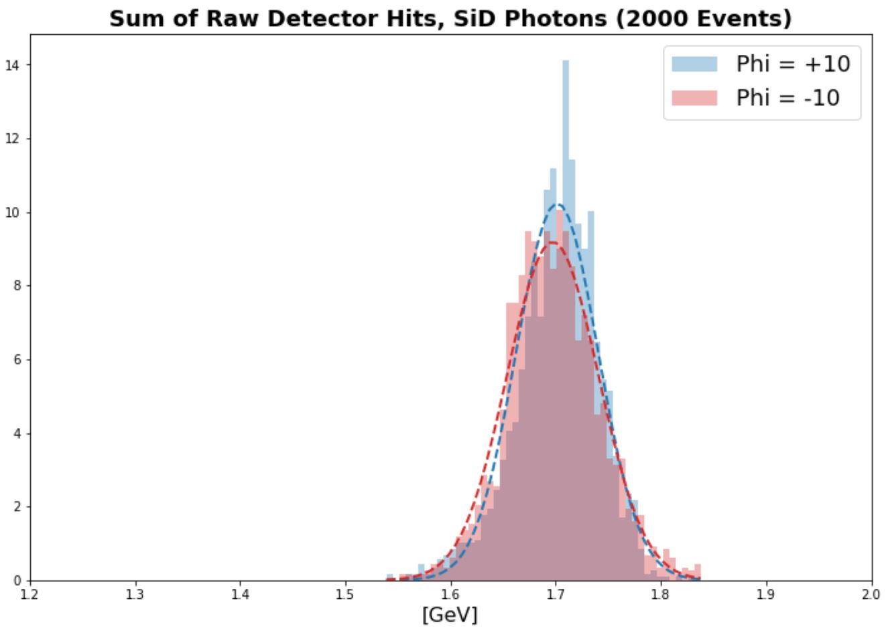
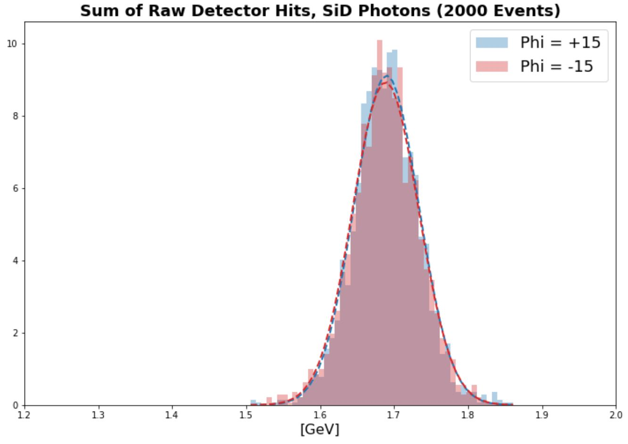
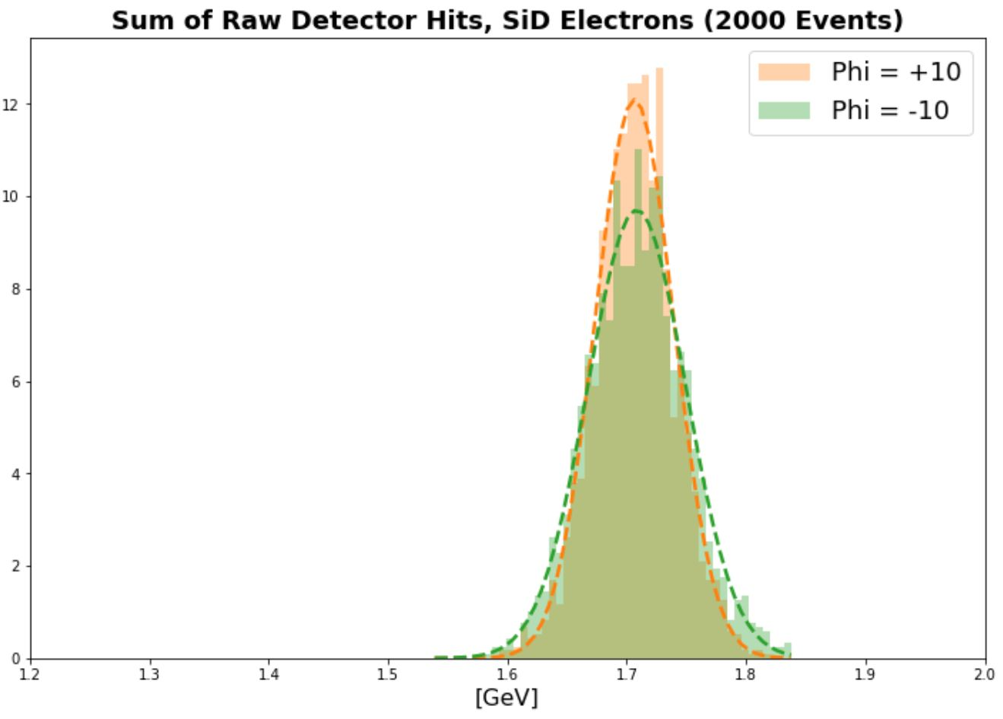
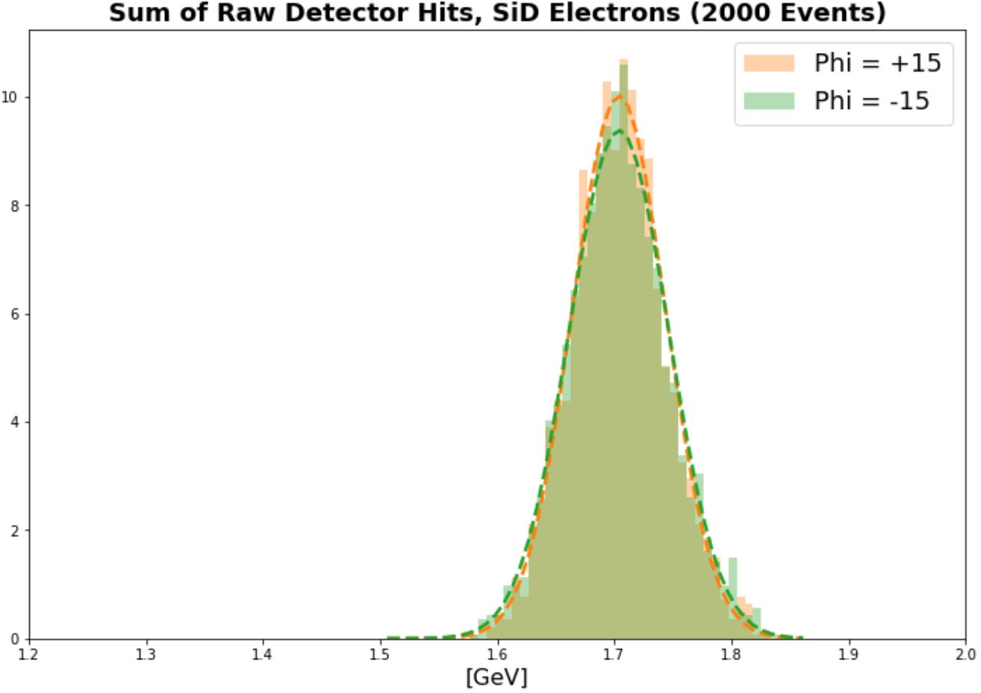
How does incident hit location in module affect resolution?

Slide 20
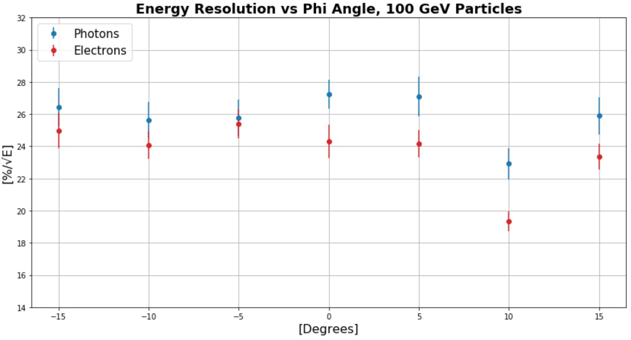
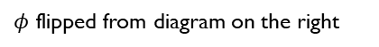

Resolution Dependence on phi
Closest overlap region to normal incidence: ~ $−4^{°}$
$φ=10°$ ensures entire shower goes through center of module
100 GeV e- at $φ=10°$ is comparable to simple stack
$φ$ flipped from diagram on the right

Slide 21


Summary of current Angular
Current SiD compares better to previous studies when incident particles are fired at $φ=10°$ instead of normal incidence
Shower mostly contained in nonoverlapping region
$φ$ flipped from diagram on the right

Slide 22



Layer Swapping
Changing to have thick layers at the front could decrease the cost as the importance of sampling goes down when the shower has yet to fully develop.
See similar resolution with 2 thick layers at the start

Slide 23

Layer Swapping
Consistently across energies see similar resolution with 2 thick layers in the front
D. Austin

Slide 24


Complete Revision of layer Strategy
Initial studies of changing the number of thick and thin layers in the calorimeter.
Not much in resolution loss in going to 18:8 but reduce necessary amount of Si layers by 4

Slide 25
Summary of SiD Results
Better understanding current results more every day
Resolution differences from initial design resolution to current design geometry
Comparison between versions of geometry can be tricky
Complimentary studies can be done for potential layer reduction of SiD ECal
Rearrange Layers
Change number of layers

Slide 26


Update On FCNC
Analysis is moving, slowly
Awaiting new MC samples
Not working on grid, no one knows why
ATLMCPROD-6008
Moving to R21
New signal and background MC

Slide 27


Top Decays
SM Top Decays
SignalEvent with FCNC Top Decay, very suppressed in SM

Slide 28
Preselection Cuts
We preselect events with objects that look like the signal
Require:
== 1 lepton
== 1 Good Photon
MET
>=2 Jets (at least one being b-tagged)
Event Duplication Removal
Expanded on slightly this time

Slide 29

Reminder – Duplicate (Overlapping) Event Removal

Slide 30

Implemented Duplicate Event Removal
Due to large influence of photons on the analysis special samples are used for major backgrounds
Increases the MC statistics of the samples with photons
Must removal events that are the same
40-50% of previous ttbar, W+Jets samples are removed with this method and replaced
Previous inclusion could hide smaller effects that could be helpful in the analysis

Slide 31






Duplicate Event Removal
No Removal
Just Major Samples
Post Removal

Slide 32
Region Implementation
Most important background to be well modeled is obvious ttbar/ttbar+gamma
Large increase in cross section at 13TeV
We craft an orthogonal region to make sure we are modeling these well
ttbar/ttbar+gamma region has been created
Preselection Cuts
>= 4 Jets (At least 1 b-tagged)
Orthogonal FCNC mass cut
Weak isolation cuts, currently

Slide 33




Data in tt+Gamma Validation Region
∆R(γj₀)
m_{SM Top}
Small average under modeling, explained most probably by previously shown errors in the older MC samples being used.
∆R(γl)
γ : p_{T}

Slide 34

Conclusions
Had been waiting for MC production to get going with R21
Held up with no end in site
Failing with site specific issues
Previously used sites have been decommissioned, replacements done work
Going forward I will be preparing and running R21 MC releases on the grid and guiding that with what I know now
Local, LXPlus
Grid

Slide 35
Questions

Slide 36
Backup

Slide 37

W-First vs Si-First simulation
Distribution of energies in simulation depending on which way the test beam was facing into the detector, small differences

Slide 38


Slide 39


Slide 40


BackScatter

